Slide 1
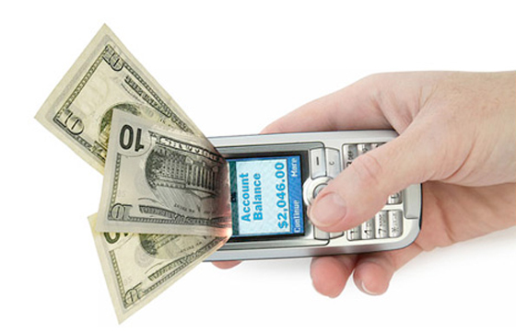
Tap-a-Tap Payments

Slide 2

Tap-a-Tap...?
Tap-a-Tap is a simple tap-to-pay payments method where your payments are just a tap away!

Slide 3
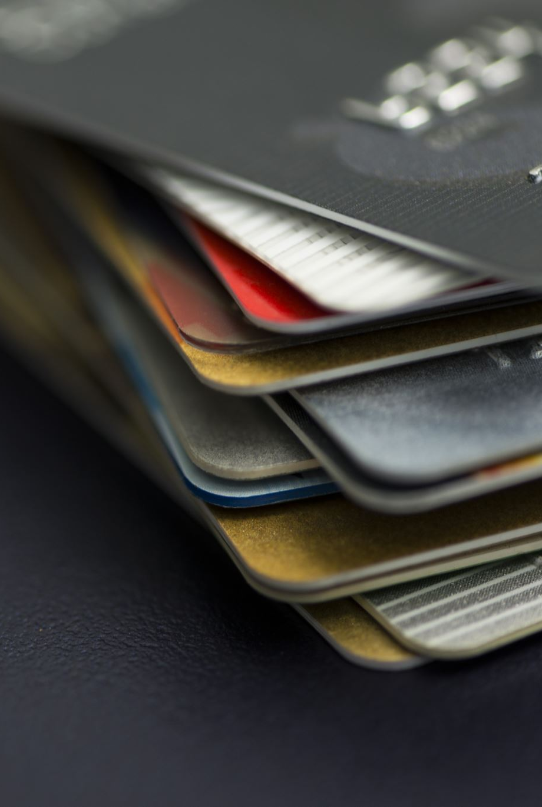
Problem Definition
The current prevailing monetary transaction process either involves cash or usage of e-wallets or UPI. Carrying of cash itself is a hassle of its own let alone remembering PINs for online payments.
Shop owners on the other hand face the difficulty of tracking payments during rush hours, etc.

Slide 4
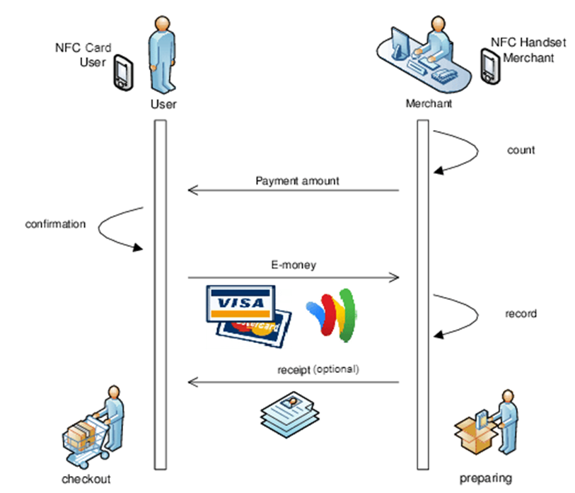
A simple flowchart to understand how the payments work.

Slide 5

Working Principle
The concept here at play is the RFID technology. Since the ID cards contain a chip with a reasonable amount of memory space, they can act as a NFC (a subset of RFID communication) card storing the student's Registration Number, verified by the Institute as well as the payments app while paying.

Slide 6

Technical Requirements
Valid ID card
A NFC supporting device
A valid online wallet – both sender and receiver ends
Setting up transaction limits to avoid misuse

Slide 7

Tech Stack
Back-end
Python
JavaScript
MySQL
Flask Web Framework with Jinja2
Front-end
HTML5
CSS
JavaScript

Slide 8
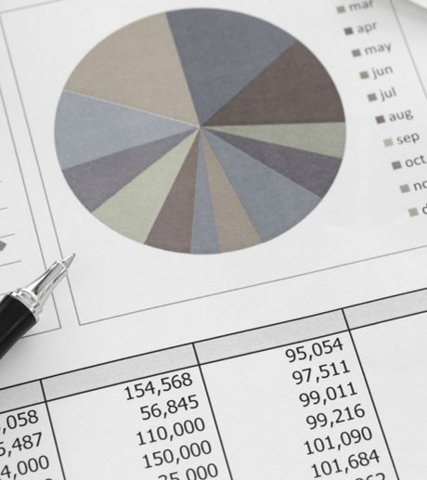
Budget
Till date the budget requirement is nil
However, in the upcoming future, based on the software usage, monetary requirement can prevail.

Slide 9

Targeted Audience
Currently, the targeted audience includes the students of SRMIST.
However, future implementations may include several other institutional bodies.

Slide 10
SWOT Analysis
STRENGTHS
Interoperability and Multifunctional
Fast communication/transaction
High Security Standards
Esthetically less invasive than a QR Code
Highly promoted by groups, associations (NFC forum, GSMA, Telco) and some different companies
Consumer can get highly targeted products/services
WEAKNESSES
High Investment on POS, SIM and device
Need to get a critical mass beforehand to get foothold in the market
OPPORTUNITIES
Interoperability and Multifunctional
Fast communication/transaction
High Security Standards
Esthetically less invasive than a QR Code
Highly promoted by groups, associations (NFC forum, GSMA, Telco) and some different companies
Consumer can get highly targeted products/services
THREATS
Many competitor technologies
Contactless Payments markets heterogeneity and competition
Users resistance to changes

Slide 11

Future Implementations
This software can be implemented in various fields such as Historical sites, online OTT streaming platforms, etc. which accommodate student discounts .

Slide 12

Thanks for giving your valuable time!

